Slide 1
BB2950 Day 9: Tuesday 11-7-17
Learning objectives:
Describe DNA supercoiling, the purpose it serves in cells, and the processes that introduce and relax supercoils.
Describe the reaction by which bacterial topoisomerase I relaxes supercoils.
Describe the role and basic structure of nucleosomes.
Diagram the replication fork and explain how it functions to replicate chromosomal DNA.
Explain the role of each of the E. coli replication proteins.

Slide 2
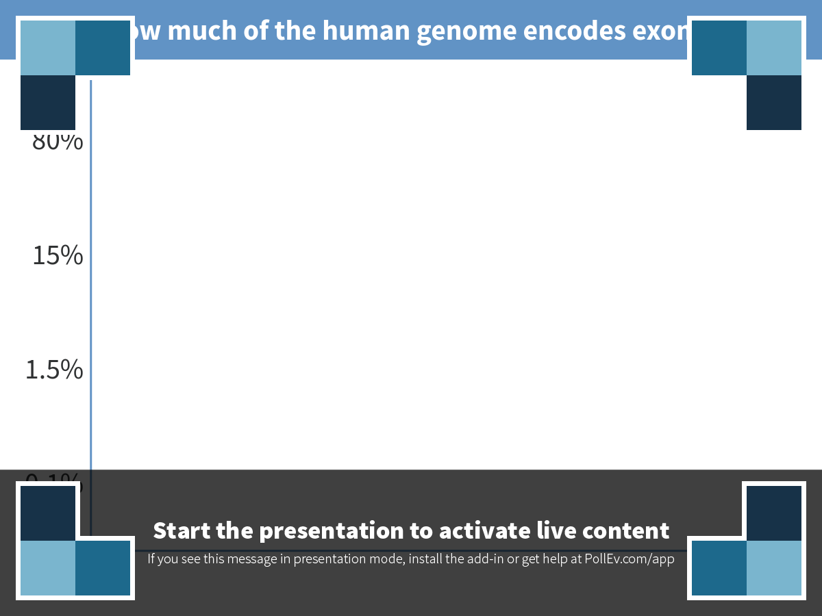
Notes:
How much of the human genome encodes exons?
https://www.polleverywhere.com/multiple_choice_polls/7fLLYQNRnY3JojU

Slide 3
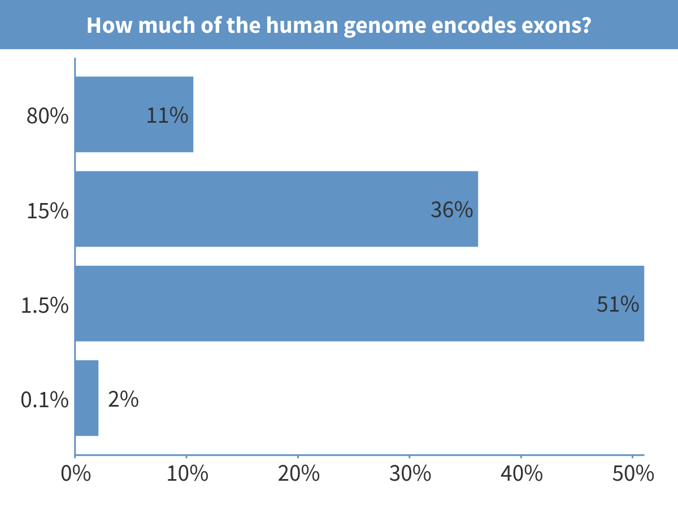
Notes:
How much of the human genome encodes exons?

Slide 4
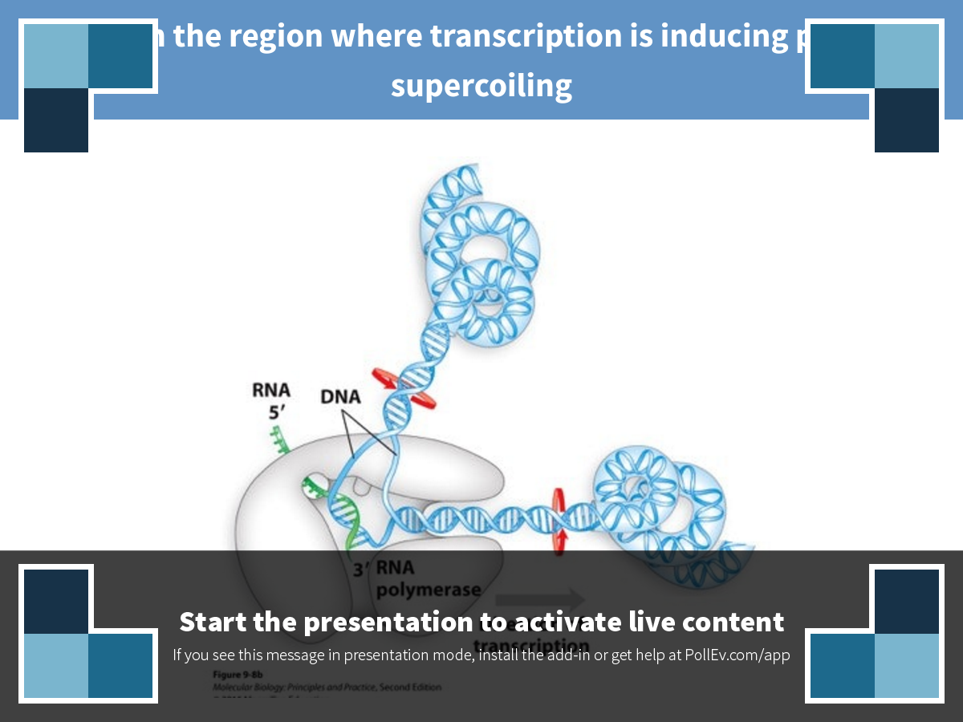
Notes:
Click on the region where transcription is inducing positive supercoiling
https://www.polleverywhere.com/clickable_images/dU898snAydS3cpL

Slide 5
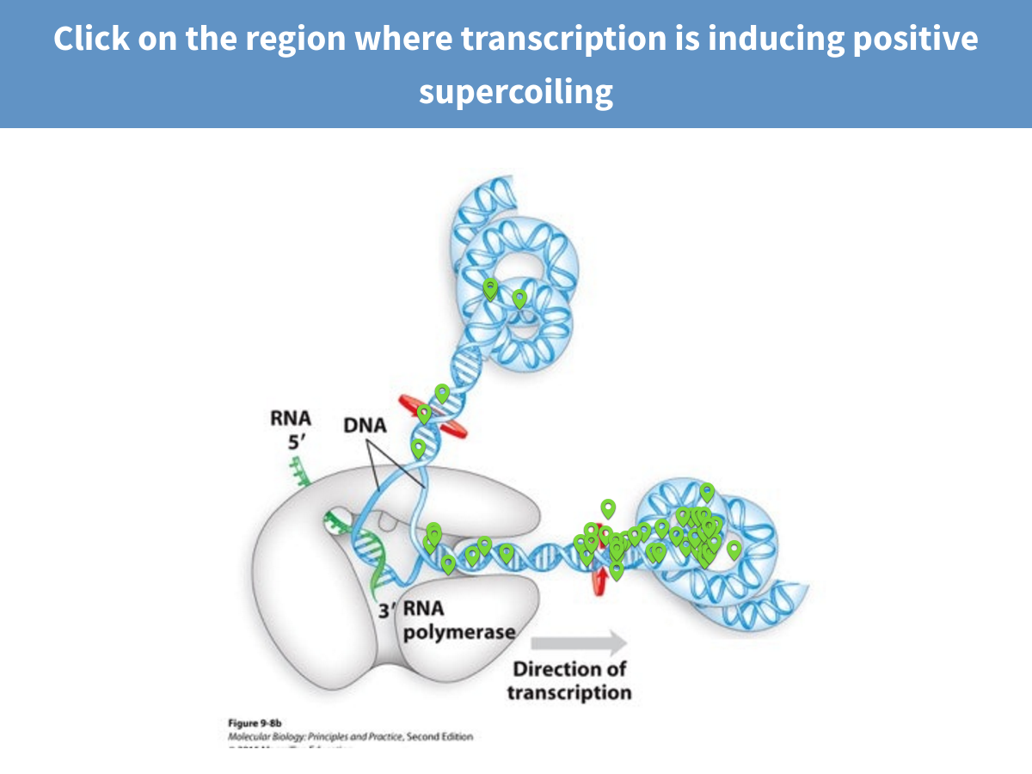
Notes:
Click on the region where transcription is inducing positive supercoiling

Slide 6
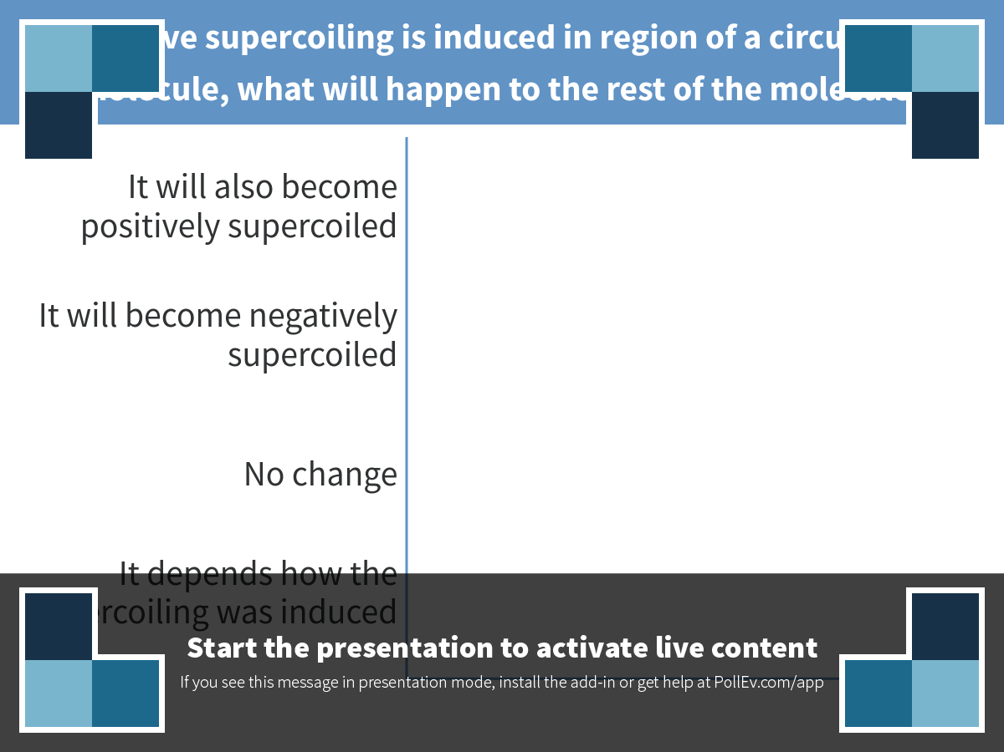
Notes:
If positive supercoiling is induced in region of a circular DNA molecule, what will happen to the rest of the molecule?
https://www.polleverywhere.com/multiple_choice_polls/tJIouxBE1rjo44O

Slide 7
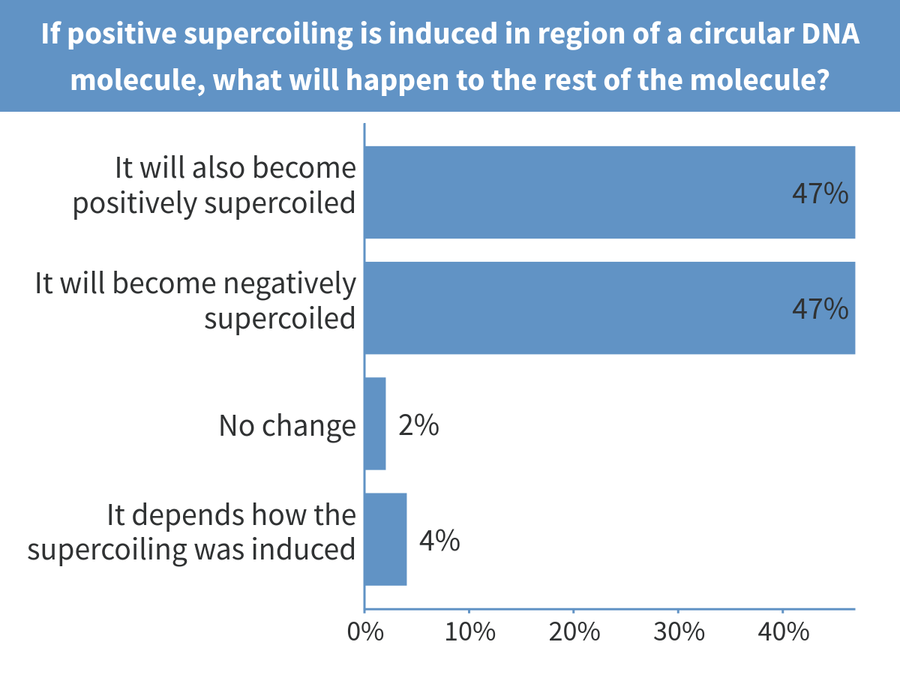
Notes:
If positive supercoiling is induced in region of a circular DNA molecule, what will happen to the rest of the molecule?

Slide 8
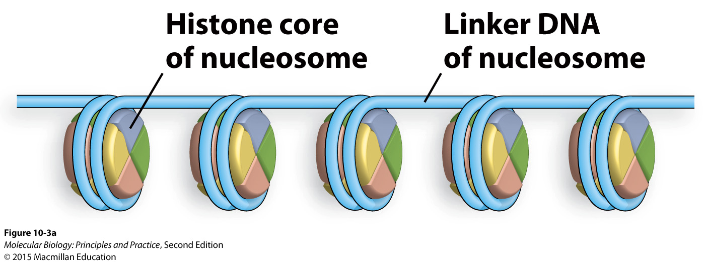
Less obvious, but this DNA is supercoiled too

Slide 9
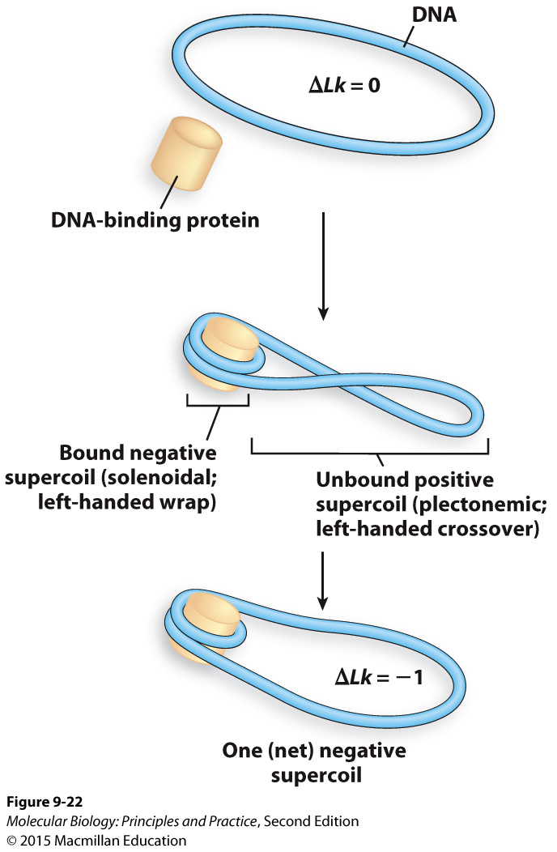
Cells use both protein binding and topoisomerases to introduce and relax supercoils

Slide 10
Sources of supercoiling

Slide 11
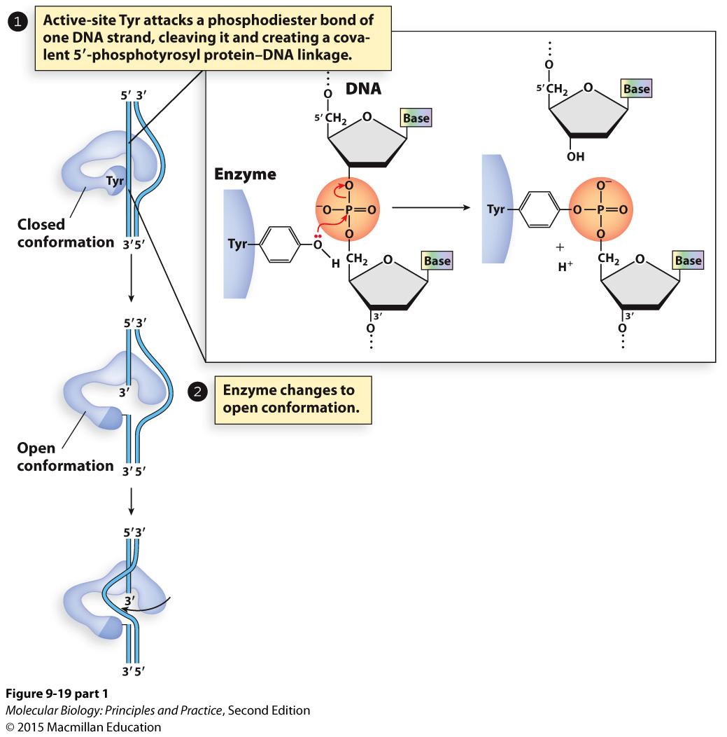
Bacterial topoisomerase I relaxes negative supercoiling by breaking and re-ligating one strand

Slide 12
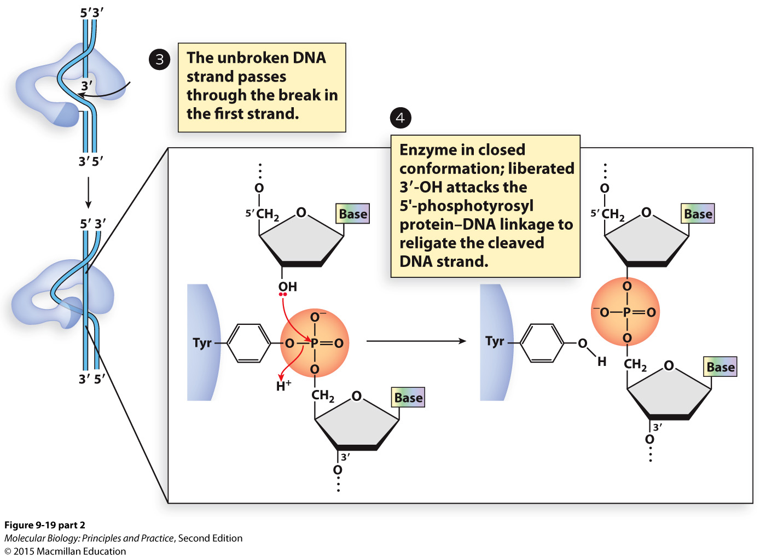

Slide 13
Bacterial topoisomerase I demonstrates a common reaction mechanism: replace one high-energy bond with another at each step.
Other types of topoisomerases break and re-ligate both strands.
In general: phosphodiester bonds are made and broken by nucleophilic attacks on phosphorus atoms in phosphate groups.

Slide 14
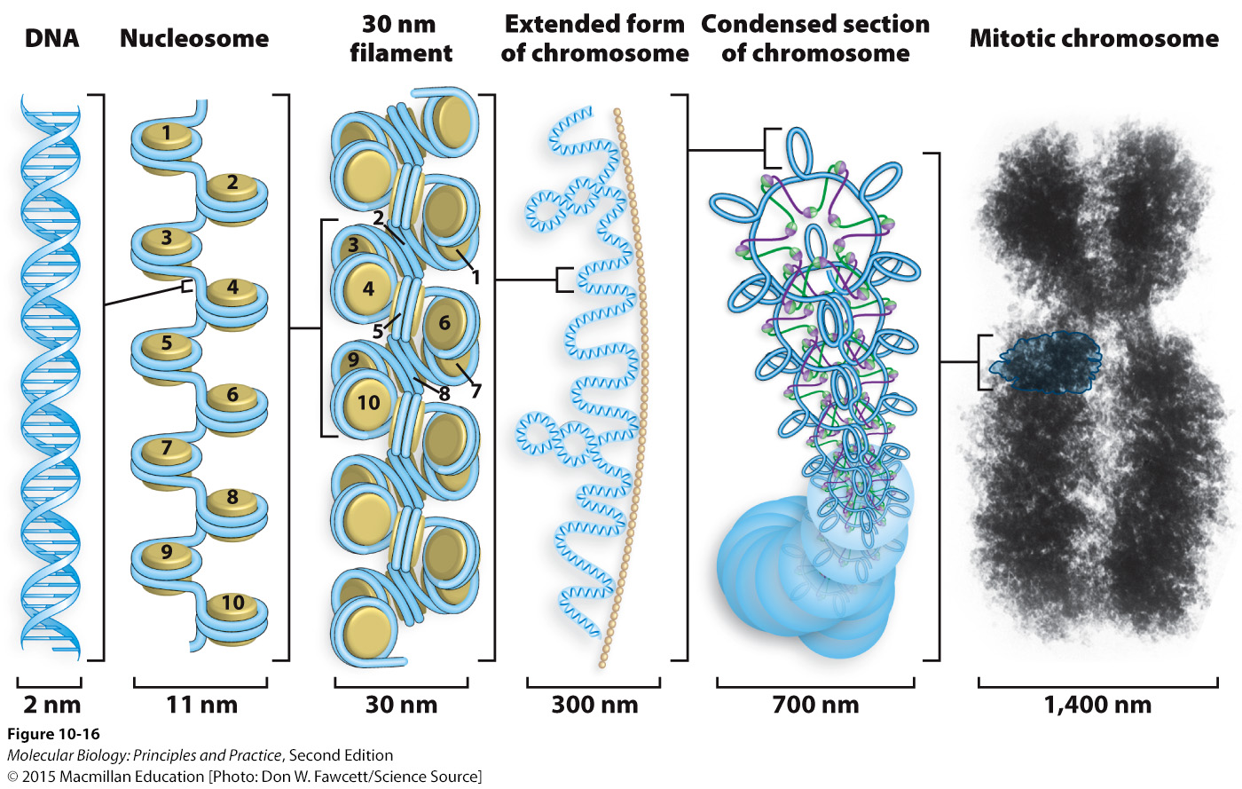
In eukaryotes, nucleosomes are the first level of DNA compaction

Slide 15
146 bp of DNA wrap around each histone core (octomer)

Slide 16
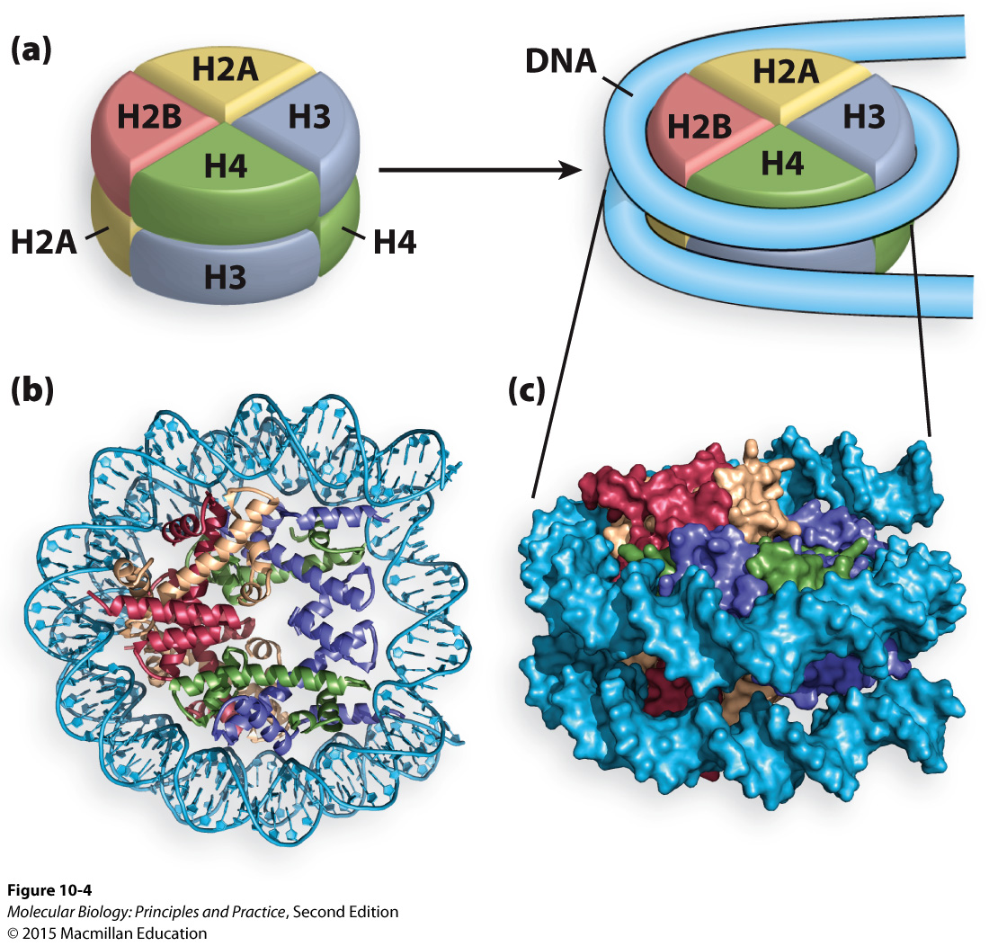
Notes:
On board: each histone core is composed of eight polypeptides: tetramer of 2 each H3 and H4 and a tetramer of two each H2A and H2B

Slide 17
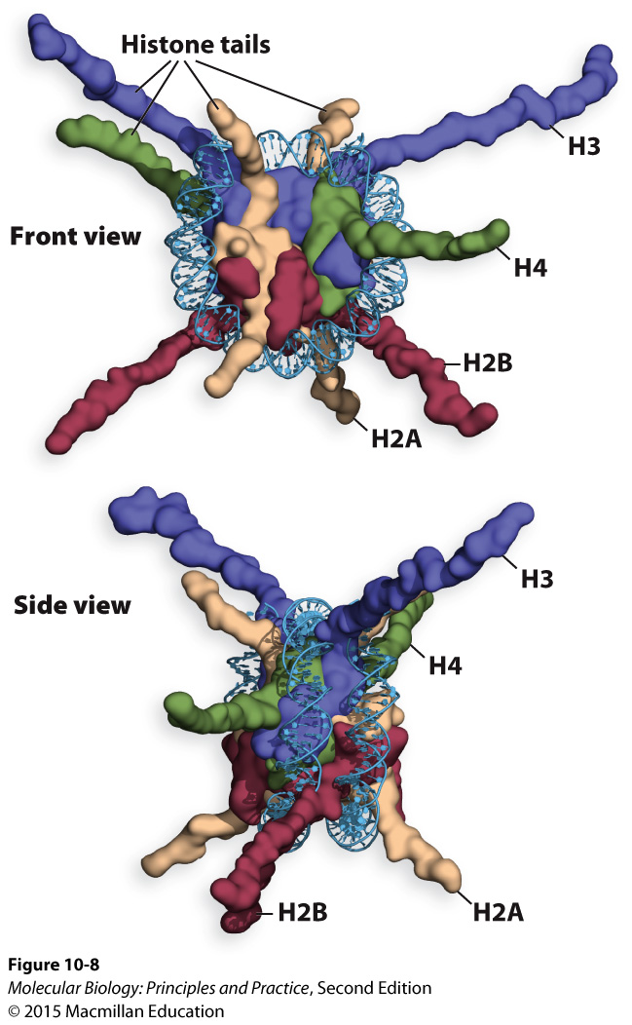
Histone tails contribute to the formation of higher-order chromatin structure and regulation of transcription
Histones must be removed for transcription to occur
Tails are often posttranslationally modified

Slide 18
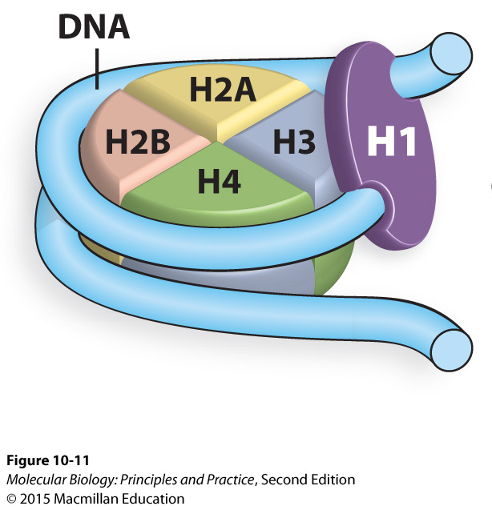
Histone H1 facilitates higher-order compaction and generally represses transcription

Slide 19
Prokaryotes do not have histones, but have histone-like proteins that perform analogous functions

Slide 20
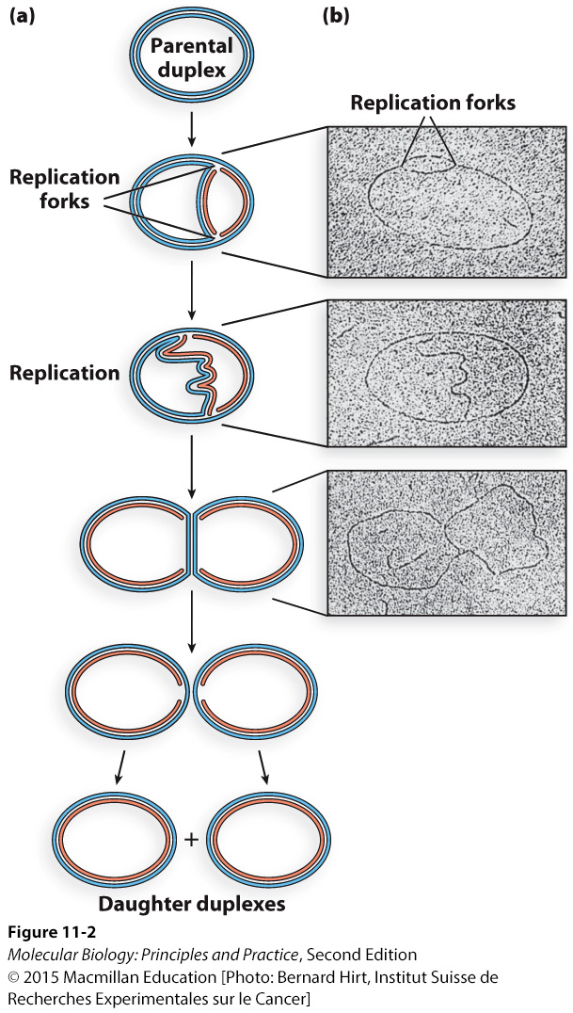
DNA replication initiates at an origin of replication and proceeds bidirectionally
A plasmid or circular chromosome is replicated from a single origin
Each daughter plasmid/chromosome has one old strand and one new strand

Slide 21
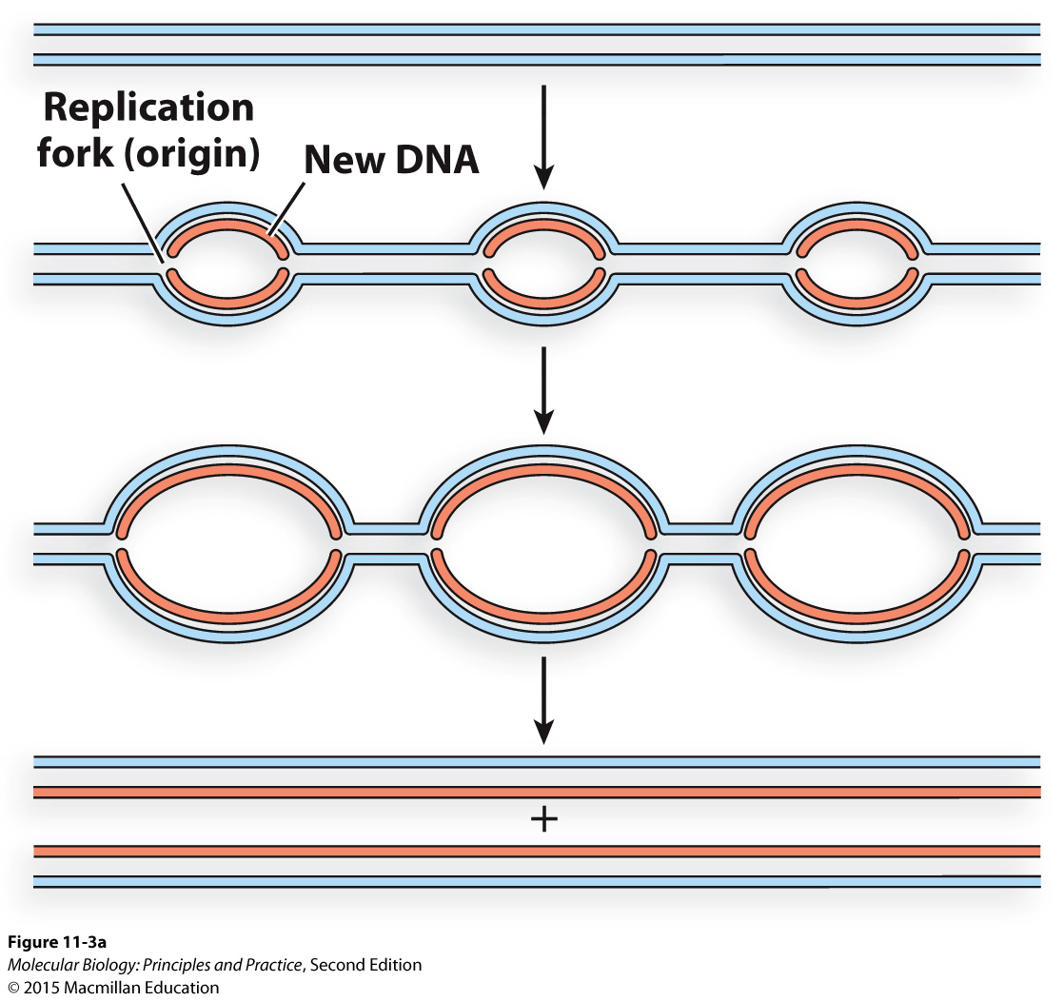
Multiple origins fire to replicate linear eukaryotic chromosomes

Slide 22
One origin -> two replication forks
Each replication fork has two strands being simultaneously copied

Slide 23
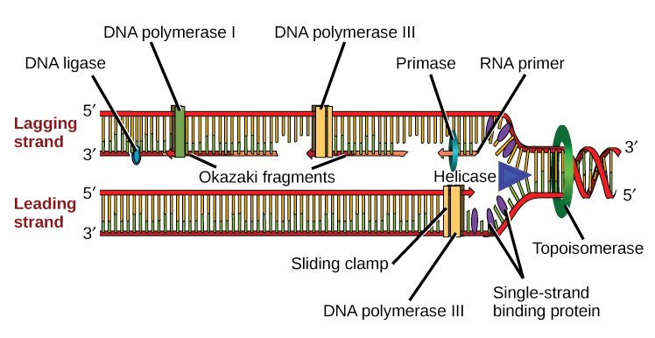
The major players at the (bacterial) replication fork
Image: Khan Academy

Slide 24
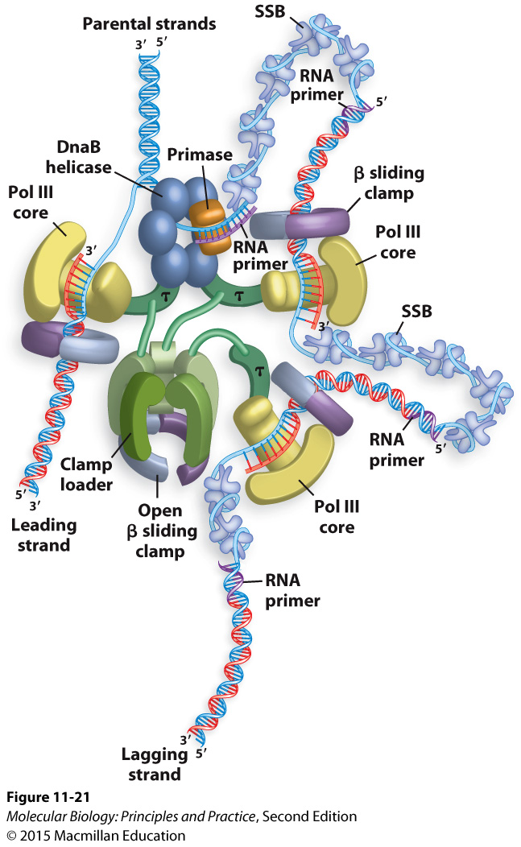
What other proteins are required to complete replication?
Notes:
(topoisomerase, Pol I, ligase)

Slide 25
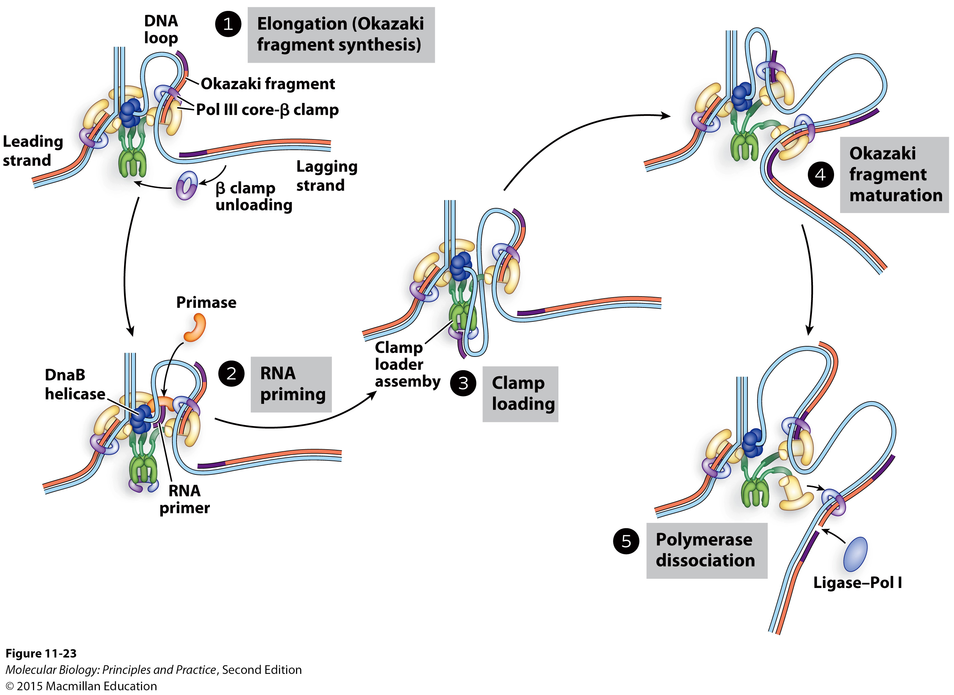
The clamp loader continually replenishes Pol III and Beta clamp on the lagging strand, and spatially links leading and lagging strand synthesis.

